Slide 1
Capstone Project 2 :- Real Estate Price Prediction
Submitted by:-
Vijendra Datkhile

Slide 2
TABLE OF CONTENTS
Machine Learning
Introduction to Project
Aim and Importance
Tools and Technologies Used
Dataset
Project Implementation
Result
Conclusion and Future Scope

Slide 3

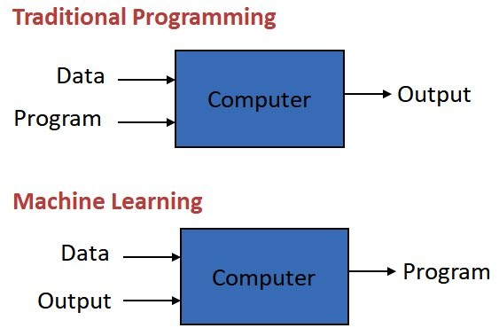
Machine Learning
Definition
"Field of study that gives computers the ability to learn without being explicitly programmed"
"A computer program is said to learn from experience E with respect to some class of tasks T and performance measure P, if its performance at tasks in T, as measured by P, improves with experience E."
The complexity in traditional computer programming is in the code (programs that people write).
In machine learning, algorithms (programs) are in principle simple and the complexity (structure) is in the data.
That is, machine learning is the about the construction and study of systems that can learn from data.
This is very diﬀerent than traditional computer programming.

Slide 4

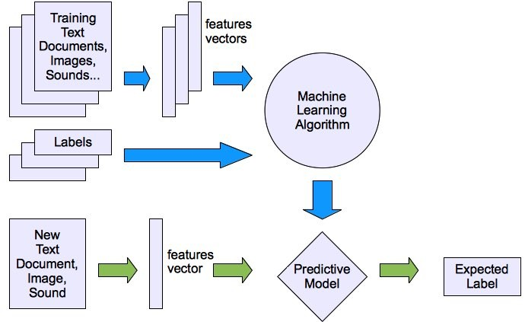
Types of Learning Algorithms
Two types of learning algorithms are commonly used:
Supervised learning
Teach the computer how to do something, then let it use it's new found knowledge to do it.
Unsupervised learning
Let the computer learn how to do something, and use this to determine structure and patterns in data.
Supervised Learning
In Supervised Learning, we are given a data set and already know what our correct output should look like, having the idea that there is a relationship between the input and the output.
Supervised learning problems are categorised into "regression" and "classification" problems.

Slide 5

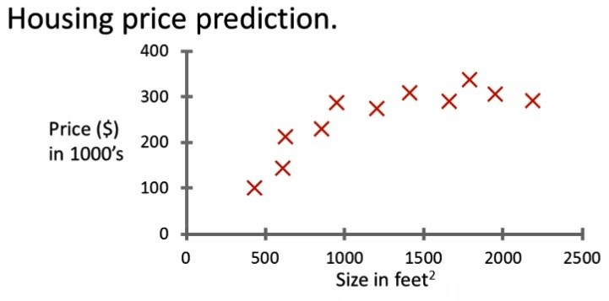

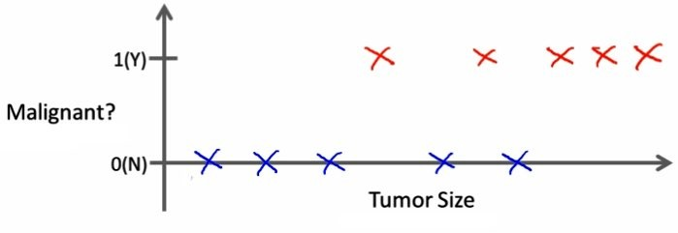
In a Regression problem, we are trying to predict results within a continuous output, meaning that we are trying to map input variables to some continuous function.
In a Classification problem, we are instead trying to predict results in a discrete output. In other words, we are trying to map input variables into discrete categories.
Example 1:
Given data about the size of houses on the real estate market, try to predict their price. Price as a function of size is a continuous output, so
this is a regression problem.
Example 2:
Given a patient with a tumor, we have to predict whether the tumor is malignant or benign. Since output can be either or and not both this is a
classification problem.

Slide 6
Introduction to Project
Machine learning is a branch of Artificial Intelligence which is used to analyse the data more smartly. It automates the process using certain algorithms to minimise human intervention in the process.
Linear regression is one such machine learning tool that helps you to make predictions by using the existing data (basically the relationship between the target data and set of other data).
House price forecasting is an important topic of real estate.
In this project, we will develop and evaluate the performance and the predictive power of a model trained and tested on data collected from India (Bangalore).
Linear Regression and other Regression models are applied to analyse historical property transactions. In our case, the house price basically depends on the parameters such as the number of bedrooms, location, size of living area etc.
Once we get a good fit, we will use this model to predict the monetary value of a house located at the Bangalore area.
A model like this would be very helpful for a real state agent and sellers and buyers so as to have an overview of the real estate market.

Slide 7
Aim and Importance
In India for so many years housing and rental prices have continued to rise. Since the housing crisis of 2008, housing prices have recovered remarkably well, especially in major housing markets.
Now with the lingering impact of demonetisation, the enforcement of the Real Estate (Regulation and Development) Act (RERA), and the lack of trust in property developers in the city, housing units sold across India in 2017 dropped by 7 percent.
Buying a home, especially in a city like Bengaluru, is a tricky choice. With its millennial crowd, vibrant culture, great climate and a slew of job opportunities, it is diﬃcult to ascertain the price of a house.
Thus, a model like this would make people aware of the periodic fluctuations in the real estate market thereby maintaining transparency.
If customer finds the price of a house at some given website higher than the price predicted by the model, that property can be rejected.
Therefore, comparisons can be made easily using this model enabling customers to make a more informed decision.
Hence, our aim with this project would be to :
Create an eﬀective price prediction model.
Identify the important home price attributes which feed the model’s predictive power.
Validate the model’s prediction accuracy.

Slide 8







Tools and Technologies Used
Machine learning : Machine learning is a method of data analysis that automates analytical model building. It is a branch of artificial intelligence based on the idea that systems can learn from data, identify patterns and make decisions with minimal human intervention.
Python : Python is an interpreted, high-level and general-purpose programming language which emphasises code readability with its notable use of significant whitespace.
Libraries used in this project include:
Pandas : A fast, powerful, flexible and easy to use
open source data analysis and manipulation tool, built on top of the Python programming language.
NumPy : Library for the Python programming language, adding support for large, multi- dimensional arrays and matrices, along with a large collection of high-level mathematical functions to operate on these arrays.
Matplotlib : Matplotlib is a comprehensive library for creating static, animated, and interactive visualizations in Python.
Scikit Learn : It is a machine learning library for the Python programming language. It features various classification, regression and clustering algorithms.

Slide 9

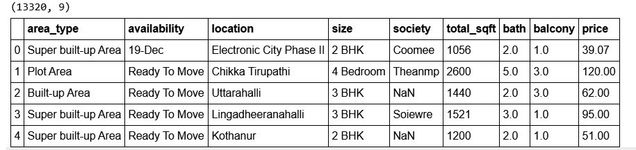

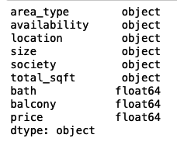
DATASET
The dataset used in this project comes from a Machine Learning Repository.
This data was collected in 2018 and each of the 13320 entries represents aggregate information about 9 features of homes from various properties located in Bangalore, India.
Our Data contains Bangalore houses only. Dataset looks as follows-
The features extracted for each house are the following :
area_type
availability
location
size
society
total_sqft
bath
balcony
price

Slide 10

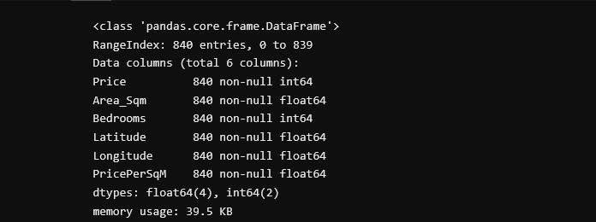
Project Implementation
Implementation of the project model can be categorised into several important sub-processes namely:
Data Preprocessing
Data Cleaning
Feature Engineering
Dimensionality Reduction
Outlier Removal Using Business Logic
Model Building
GUI Application
Data Preprocessing
Data Exploration
Data exploration is the first step in data analysis and typically involves summarising the main characteristics of a data set, including its size, accuracy, initial patterns in the data and other attributes. Before it can conduct analysis on data collected by multiple data sources and stored in data warehouses, an organization must know how many cases are in a data set, what variables are included, how many missing values there are and what general hypotheses the data is likely to support.
We divided the data 8:2 for Training and Testing purpose respectively.

Slide 11

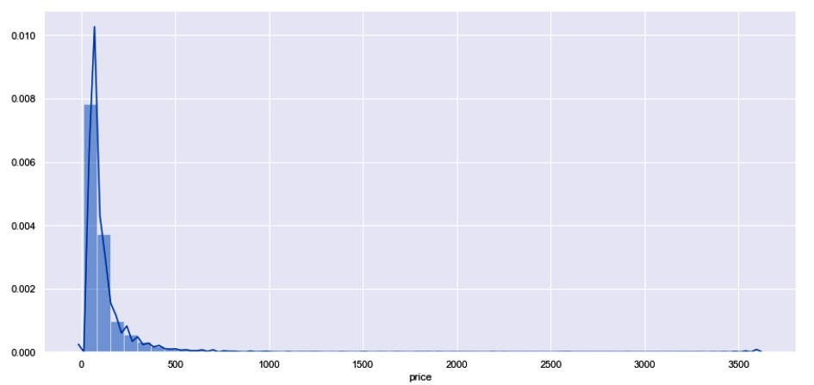

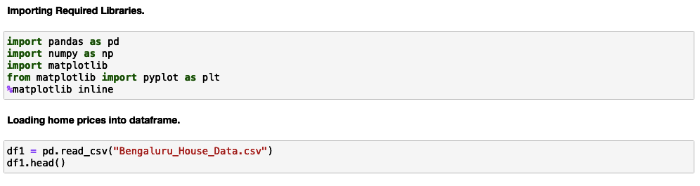
Data Visualisation
Data visualisation is the graphical representation of information and data. By using visual elements like charts, graphs, and maps, data visualisation tools provide an accessible way to see and understand trends, outliers, and patterns in data. In the world of Big Data, data visualisation tools and technologies are essential to analyse massive amounts of information and make data-driven decisions.
Loading Data and Importing Libraries
Import the dependencies and libraries to perform computations on the data. Also dataset (.csv) file is to be loaded.

Slide 12

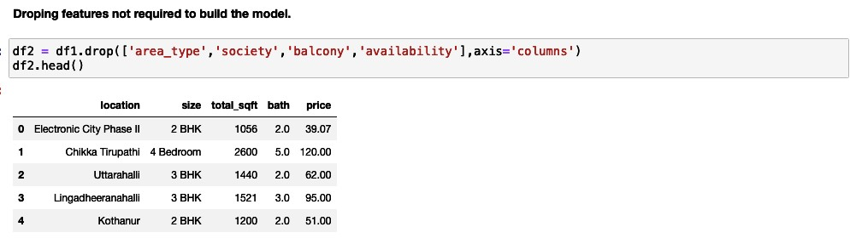

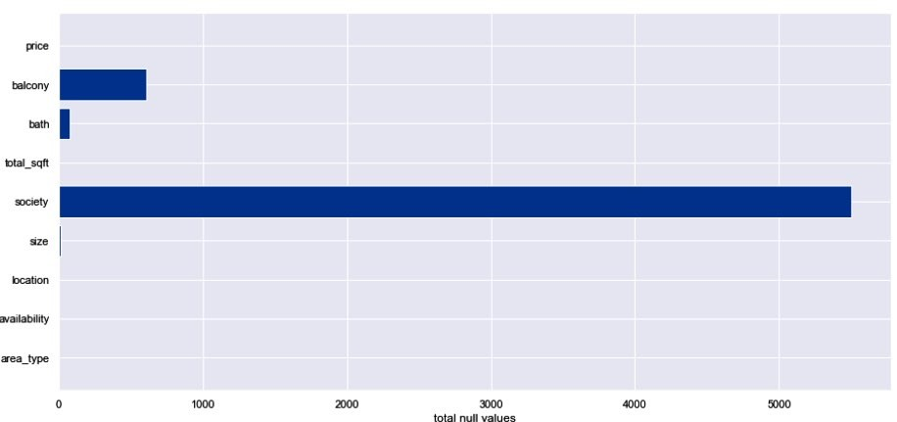
Data Cleaning
This involves dropping features not seen to be necessary for our price prediction model since their impact on determining the final price is not much.
Dropping these features will have little to no eﬀect on our model.
When working on analysing data, you’ll likely come across data that is missing (also called null values or NaNs).
Data cleaning is an important part of data analysis pipeline and making sure that it’s all tidy up will make the analysis much stronger.

Slide 13

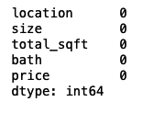

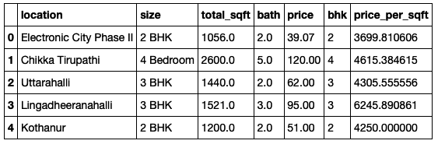
So we just remove any rows or columns that contain missing values. Pandas does have a handy function, dropna() to help you do this.
df2.isnull().sum()
df3 = df2.dropna() df3.isnull().sum()
Feature Engineering
Feature engineering is the process of using domain knowledge to extract features from raw data via data mining techniques.
These features can be used to improve the performance of machine
learning algorithms. Feature engineering can be considered as applied machine learning itself.
Importance of feature engineering is:
Better features means flexibility.
Better features means simpler models.
Better features means better results.
Since our machine learning model can only make use of numerical data, we engineer new data columns having numeric values corresponding to columns containing character data.
Adding a new feature bhk in place of size column and adding a feature price per square feet.

Slide 14

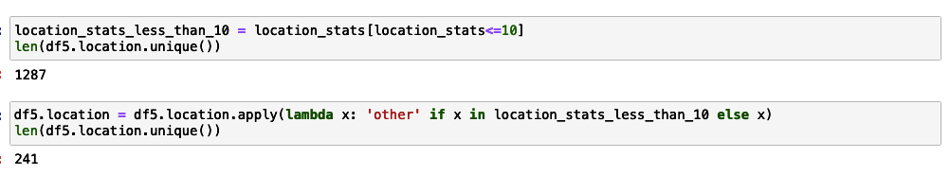

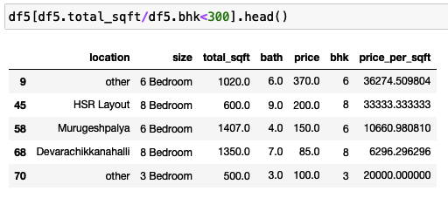
Dimensionality Reduction
Dimensionality reduction, or dimension reduction, is the transformation of data from a high-dimensional space into a low- dimensional space so that the low-dimensional representation retains some meaningful properties of the original data, ideally close to its intrinsic dimension.
Any location having less than 10 data points are tagged as "other" location. This way number of categories can be reduced by huge amount.
Outlier Removal Using Business Logic
Outliers are unusual values in the dataset that distort statistical analysis and violate their assumptions. Given the problems they can cause, you might think that it’s best to remove them from your data.
Normally square ft per bedroom is 300 (i.e. 2 bhk apartment is minimum 600 sqft. If you have for example 400 sqft
apartment with 2 bhk then that can be removed as an outlier.

Slide 15

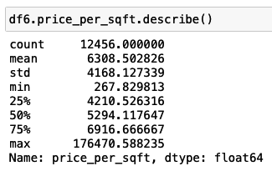

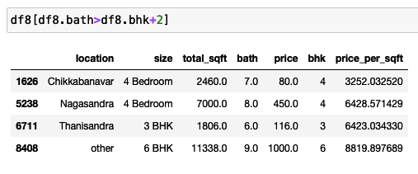

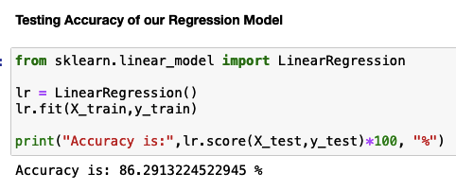
Here, min price per sqft is 267 whereas max is 176470, showing a wide variation in property prices.
These outliers are removed per location using mean and one standard deviation.
Even for a 4 bhk, it will at-most have bathroom in all 4 rooms plus one guest bathroom. Anything above that is an outlier which is removed.
Model Building
Using Scikit Learn machine learning library for the Python programming language we initialize the linear regression model.
Furthermore the dataset is split into 80% as training and 20% as testing data.
Finally the model is trained with our training data.
Upon testing our model returns a prediction accuracy of 86% which will work well enough.

Slide 16

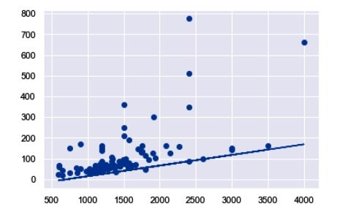

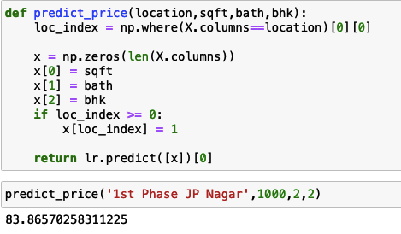
Linear Regression is a machine learning algorithm based on supervised learning.
It performs a regression task. Regression models a target prediction value based on independent variables.
The final price prediction function takes location, area in square feet, number of bedrooms (bhk) and number of bathrooms as inputs and returns the predicted price in lakhs (rupees).

Slide 17

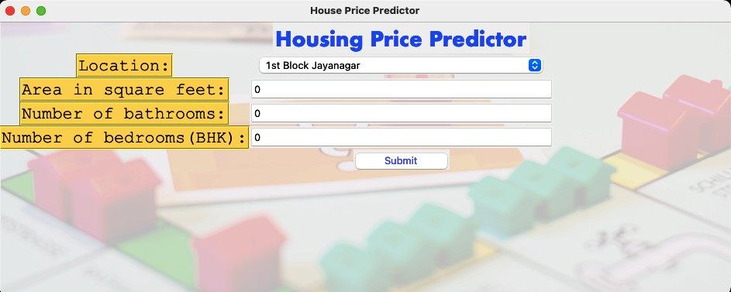
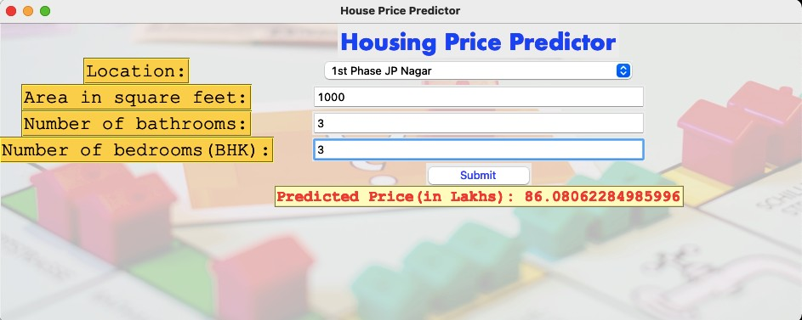
GUI Application
Here the linear regression model is deployed to a Graphical User Interface (GUI) in order to make it more appealing and presentable.
The GUI application is made in python itself using the Tkinter library.
Tkinter is a Python binding to the Tk GUI toolkit. It is the standard Python interface to the Tk GUI toolkit, and is Python's de facto standard GUI.

Slide 18

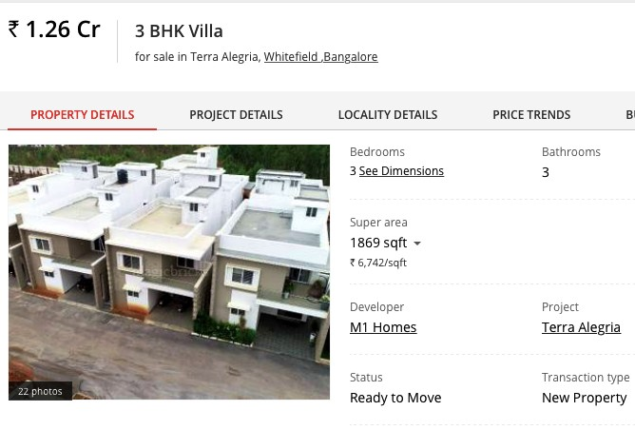

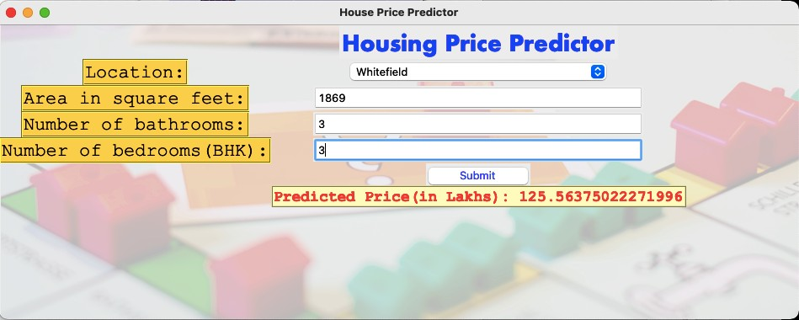
Result
So, our Aim is achieved as we have successfully ticked all our parameters that we sought to complete.
It is seen that Location is the most eﬀective attribute in predicting the house price and that the Linear Regression is the most eﬀective model for our Dataset with accuracy score of 86%.
Comparing the price of a property found on a real estate website
( magic bricks ) to the price predicted by our Linear Regression Model.
Actual Price - 1.26 crore
Predicted Price - 1.25 crore

Slide 19

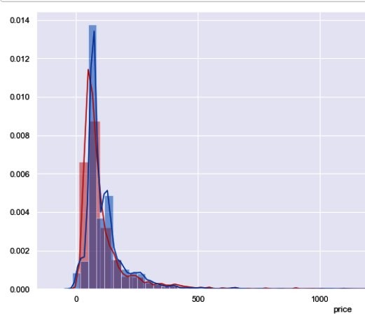
Conclusion and Future Scope
In today’s real estate world, it has become tough to store such huge data and extract them for one’s own requirement.
Also, the extraction, analysis and cleaning of data has to be done is such a way such that it proves to be useful.
This system makes optimal use of the Linear Regression Algorithm. It makes use of such data in the most eﬃcient way.
RED — TRUE VALUES
BLUE — PREDICTED VALUE
This model could help to fulfil customers by increasing the accuracy of estate choice and reducing the risk of investing in an estate.
A lot of features can be added to make the system more widely acceptable such as:
One of the major future scopes is adding estate database of more cities which will provide the user to explore more estates and reach an accurate decision.
More factors like recession that aﬀect the house prices could be added.
In-depth details of every property could be added to provide ample details of a desired estate.
This will help the system to run on a larger level and thus scaling it for widespread use.

